Slide 1




Shelter Animal Outcomes
-A Topic of Social Good
CS 513 Knowledge Discovery in Database Final Project
Instructor: Kasha Dehnad
Team Member:
Wenyi Chen Haotian Huang Hanzhuo Li Vijay Sarathy

Slide 2
Outline
Project Background
Data Understanding
Data Processing
Data Mining
Outcomes & Recommendation

Slide 3
Project Background
Every year, about 7.6 million companion animals end up in US shelters.
As many as 2.7 million dogs and cats are euthanized in the US every year.
Objective
By analyzing the dataset and applying data mining models:
Understand trends in animal outcomes.
Help shelters focus their energy on specific animals

Slide 4
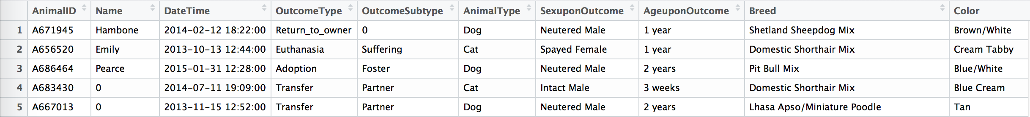
Data Understanding
Data Source
Active Competitions From www.kaggle.com
Dataset Information
Contains intake information including 10 variables: Animal ID, Outcome Type, Animal Type, breed, color, sex, age and etc. from the Austin Animal Center.
Training dataset : 26729 observations.
Testing dataset : 11456 observations.

Slide 5
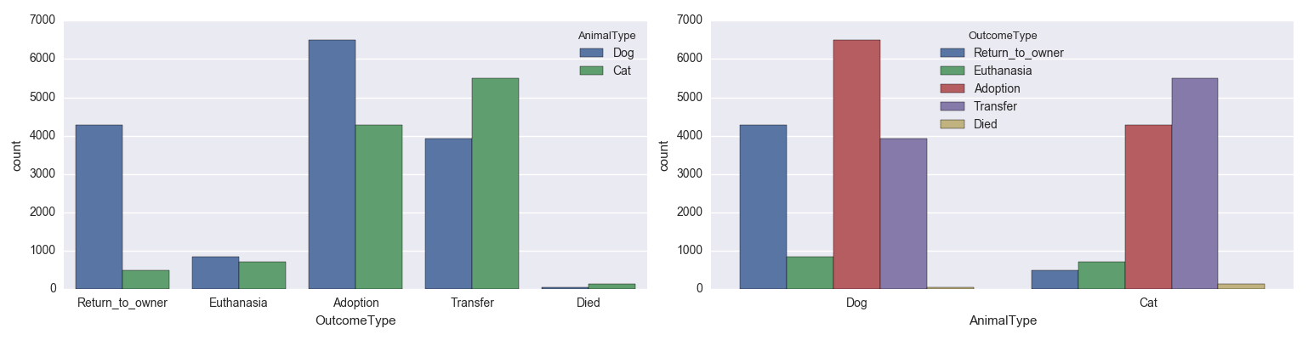
Data Understanding

Slide 6
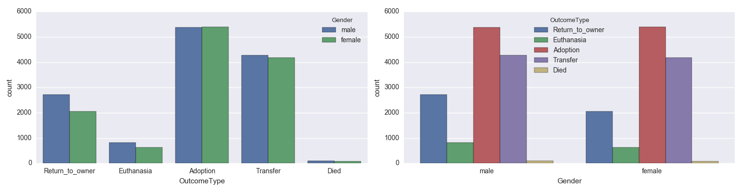
Data Understanding

Slide 7
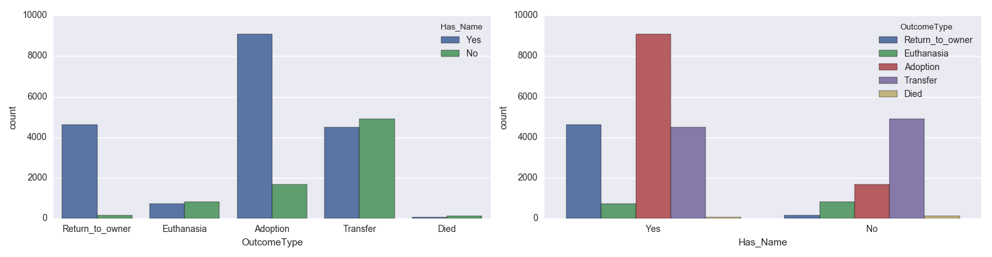
Data Understanding

Slide 8
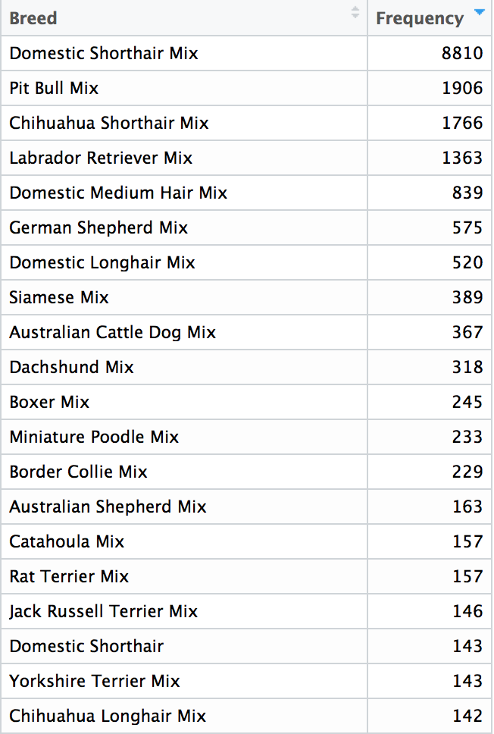
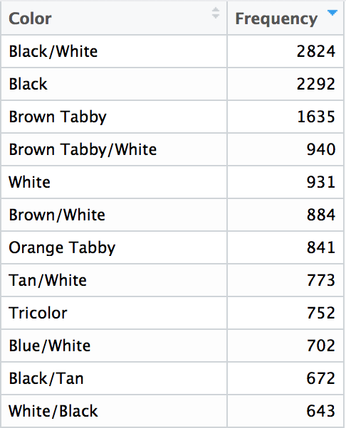
Data Understanding
Data Issues: Levels of Breed and Color
1,380 Breeds and 366 kinds of Color

Slide 9
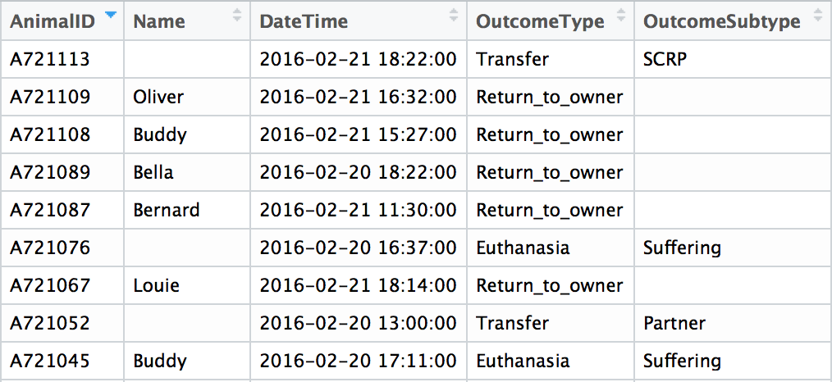
Data Understanding
Data Issues: Missing Values
7691/26729 Observations has no names

Slide 10
Data Processing
Data Partition: Training - Testing
Data Cleaning:
as.numeric()
Simple Imputation to deal with NA: Replace by 0
Normalization
Reduce Variable Levels
Age upon Outcome
0 years | 1 day | 1 week | …… | 2 years | 4 years | ……
Age upon Outcome
Less than 1 year | 2 years | 4 years | ……

Slide 11
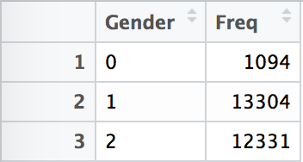
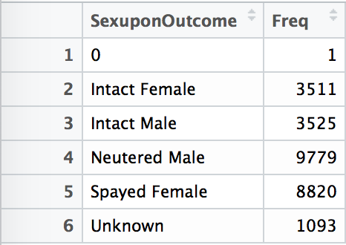
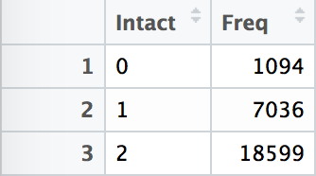
Data Processing
Data Cleaning:
Reduce Variable Levels

Slide 12
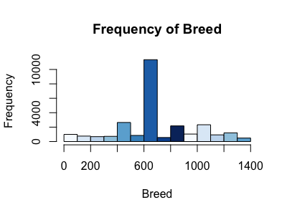
Data Processing
Data Processing:
Reduce Variable Levels
Method 1: Focus more on Range from 600 to 650
Method 2: Convert all breed type to “Mix”, “Pure” and NA

Slide 13
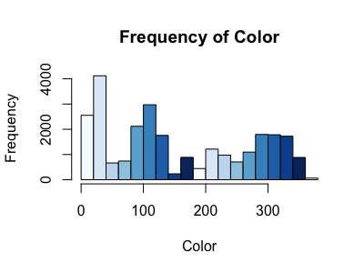
Data Processing
Data Processing:
Reduce Variable Levels
Reduce same color combinations in different orders
Focus more on Top colors

Slide 14
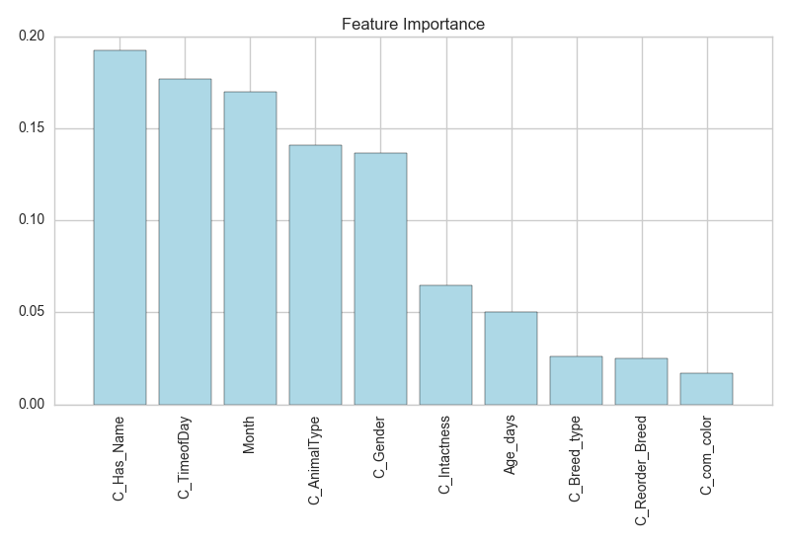
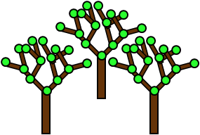
Data Processing
Using Random Forest to evaluate feature importance

Slide 15
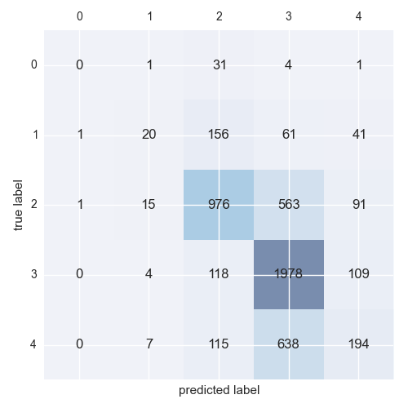
Data Mining – Decision Tree
Hyperparameters:
'Criterion': 'gini',
'Max_depth': 8
Train accuracy: 63% Test accuracy: 62%
0-died
1-euthanasia
2-adoption
3-transfer
4-return_to_owner

Slide 16

Data Mining – Random Forest
Hyperparameters:
Criterion: 'gini',
'Max_depth': 9,
'n_estimators': 48
Train accuracy: 63% Test accuracy: 62%

Slide 17
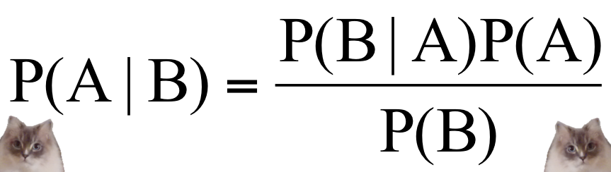
Data Mining – Naïve Bayes
 | Adoption | Died | Transfer | Return to Owner | Euthanasia
Prob. | 40.37% | 0.74% | 35.31% | 17.92% | 5.67%
Non-uniform distribution which coincides with training data
Notes:
Although overall accuracy wasn’t good (and thus not used as final model), it shows a nonuniform distribution which coincides with the training data
The poor outcomes (Died, euthanasia) account for about 6 percent, while the neutral one (transfer) accounts for about 35%.

Slide 18
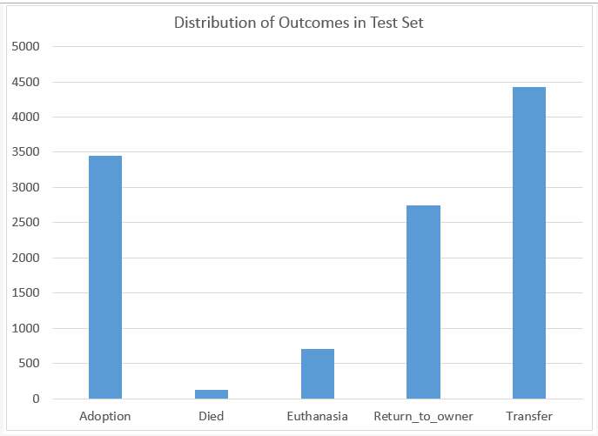
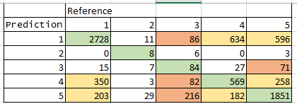
Data Mining – K-nearest neighbors
Distribution is more skewed towards “transfer”
Accuracy does not change significantly with increasing K
1 | Adoption | 4 | Return to owner
2 | Died | 5 | Transfer
3 | Euthanasia
Green | Correct
Orange | Incorrect but within favorable outcomes
Red | Discrepancy between favorable and unfavorable outcome
K | 1 | 3 | 5
Accuracy | 65.77% | 66.14% | 66.10%
Notes:
The accuracy is fairly good, but the shortcoming is that it can only predict attributes based on those that have already occurred (cannot extrapolate) . The predicted distribution also is nonuniform.
Death and euthanasia are also negligible, however, transfer accounts for more than half of the outcomes.

Slide 19
Analysis
Because we are predicting 5 categories (as opposed to 2 in a binary problem), there are multiple False positives
Some categories are in similar to one another (adoption, transfer) but others differ substantially (return to owner, euthanasia) so a variation in the prediction can either be negligible or catastrophic
However, the scope of our model is to identify animals at risk of bad outcomes as opposed to making a decision (i.e. to euthanize)
Further, precision, recall, accuracy (percent in the correct category) can still assess model performance

Slide 20
Recommendations
Devote more resources to the animals at risk (those predicted to die or be euthanized).
Dig deeper into the factors contributions to animals with successful outcomes (adopted, returned to owner).
Devise ways to reduce the transfer rate and increase adoption and return to owner

Slide 21
Thank you !
Q & A
No animals were harmed in the making of this presentation.

